Slide 1
Revizija učinka na temu JAVNE NABAVKE U REGIJI ZAPADNOG BALKANA
Doboj, 28.03.2018. godine
Hazim Šabanović, Oficir za vezu za Zapadni Balkan, Švedski državni ured za reviziju

Slide 2
Projekat regionalne paralelne revizije

Slide 3
Značaj javnih nabavki – 10% GDPa, preko 7 milijardi EUR

Slide 4
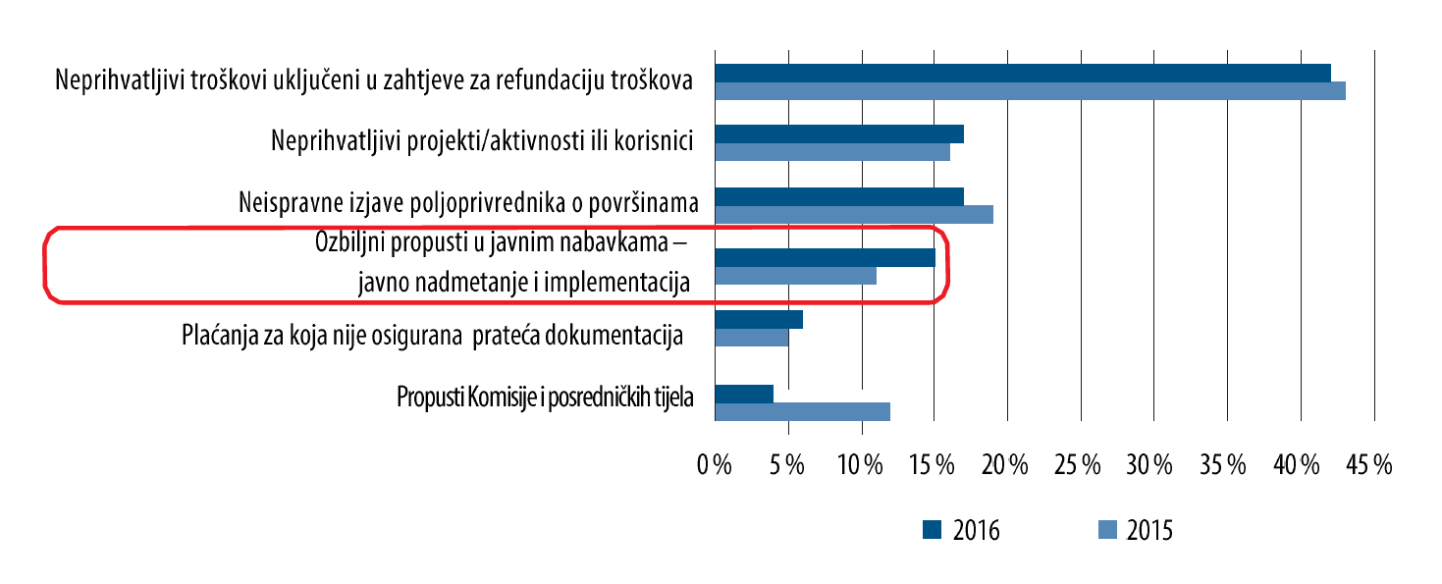
Najčešći problemi u EU koje je identifikovao Evropski revizijski sud

Slide 5
Šta je revizija, a šta je krivična istraga/proces?
Stepenice sumnje:
Razlog za vjerovati (da je počinjeno krivično djelo)
Sumnja
Razumna sumnja
Vjerovatna optužnica
Jasni i uvjerljivi dokazi
Van razumne sumnje
Van razumne
sumnje
Jasni i uvjerljivi
dokazi
Vjerovatna
optužnica
Razumna
sumnja
Sumnja
Razlog za vjerovati
Notes:
SNAO does not make criminal investigations. We are just investigating indications until they are strong enough to bring to a prosecutor for consideration and decision making. Or the indications are dismissed.
The stair case shows how an investigation effects the level of suspicion when more evidence is added. Each of these higher steps is supported by facts. The higher up you go on the staircase, the more facts you have to support an alleged crime.
From an unsupported allegation to evidence beyond reasonable doubt. Some of the steps are connected with coercive measures that law enforcement has access to.
At the level cause to believe that a crime has been committed the Prosecutor has an obligation to start criminal investigation. That is way SNAO stops the investigation at this level of suspicion.
Reasonable suspicion
The level of suspicion required for making a arrest (decision is made by Police)
Plausible cause
It is the level of suspicion which is required to make a pre-trail detention. (Decision made by court)
Beyond a reasonable doubt.
That’s the level of proof that the criminal court requires to convict somebody of a crime and punish him or her.

Slide 6
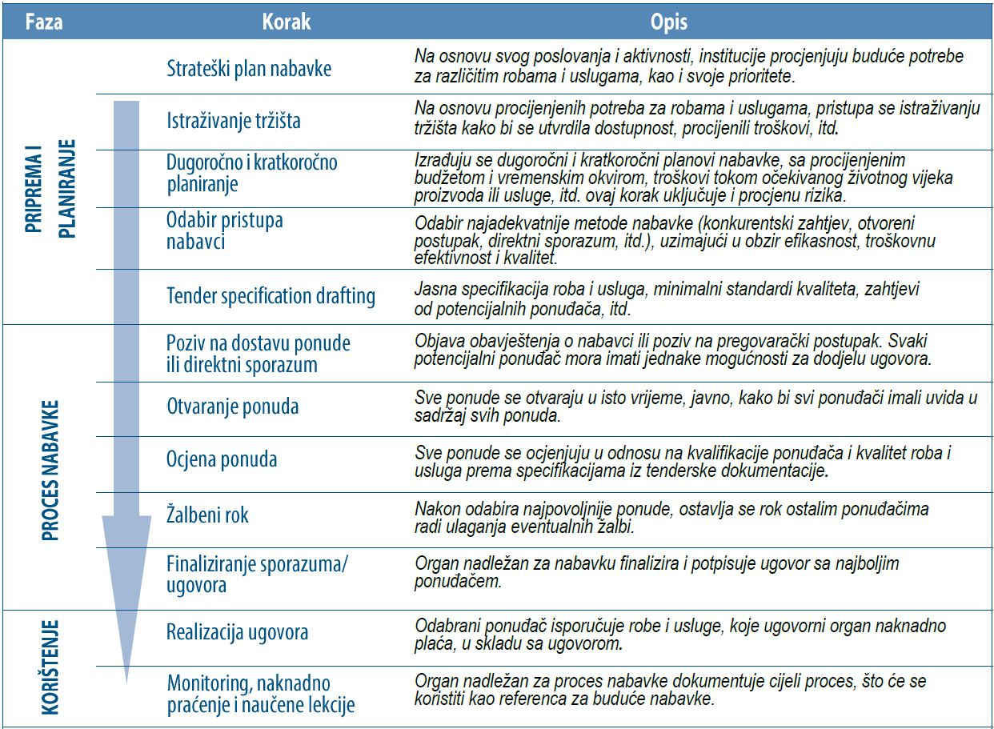

Slide 7
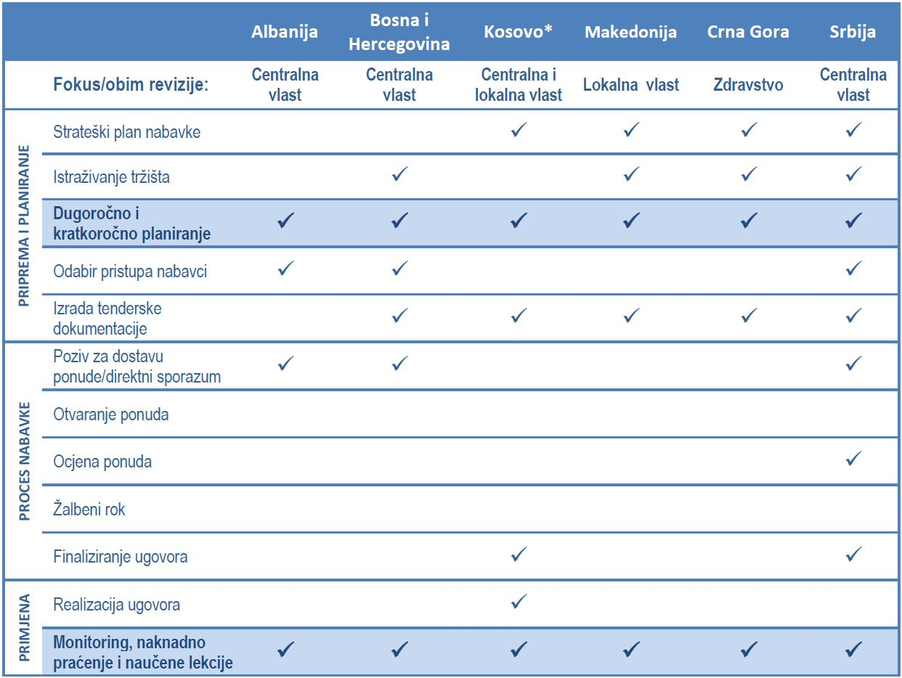

Slide 8
Hvala na pažnji! hazim.sabanovic@riksrevisionen.se

